Slide 1
Microsoft Teams User Group Berlin
21. Oktober 2021

Slide 2
Danke!

Slide 3
Agenda
18:00 - 18:15 | Landing Zone
18:15 - 19:15 | Talk 1 – Zugriff auf Teams Inhalte über Microsoft Graph Martin Gudel (@AtholyMardies)
19:15 - 19:45 | Microsoft Teams Neuigkeiten Thomas Stensitzki
19:45 – 20:45 | Talk 2 – Ultimate guide to Teams meetings Marcin Siewnicki (@MarcinSiewnicki)
20:45 - ? | Fragen und Antworten rund um Microsoft Teams Organisatorisches
Dieses Meeting wird aufgezeichnet und online bereitgestellt. This meeting will be recorded and made available online.

Slide 4
Zugriff auf Teams Inhalte über Microsoft Graph
Martin Gudel @AtholyMardies

Slide 5
Pause ☺
→ Um 19:30 Uhr geht es weiter

Slide 6
Neues in Microsoft Teams Ankündigungen & Rollouts
Updates
Meetup #15 Thomas Stensitzki

Slide 7
Neuigkeiten in Microsoft Teams
View Switcher - a new dedicated menu of view options in Teams Meetings
Music Mode for Teams (→ November)
Paging in Large Gallery – Video Gallery 3x3 (→ November)
Lists in Microsoft Teams: Comment and @mention people on list items in Teams Weitere Informationen
Microsoft Viva: Praise History in Microsoft Viva Insights (→ November) Weitere Informationen
Teams Meeting Recordings Auto-Expiration in OneDrive and SharePoint (→ November) Weitere Informationen

Slide 8
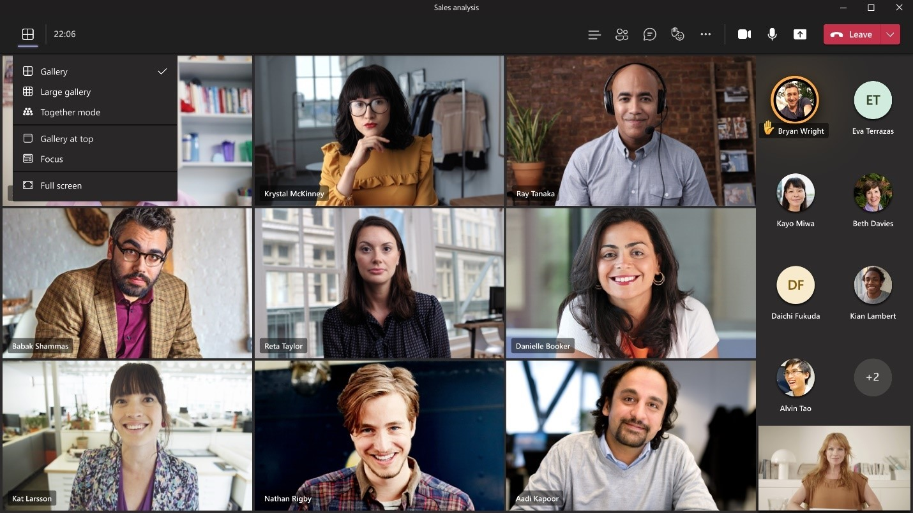
View Switcher - a new dedicated menu of view options in Teams Meetings

Slide 9
Neuigkeiten in Microsoft Teams
View Switcher - a new dedicated menu of view options in Teams Meetings
Music Mode for Teams (→ November)
Paging in Large Gallery – Video Gallery 3x3 (→ November)
Lists in Microsoft Teams: Comment and @mention people on list items in Teams Weitere Informationen
Microsoft Viva: Praise History in Microsoft Viva Insights (→ November) Weitere Informationen
Teams Meeting Recordings Auto-Expiration in OneDrive and SharePoint (→ November) Weitere Informationen
Notes:
Verschoben auf November

Slide 10
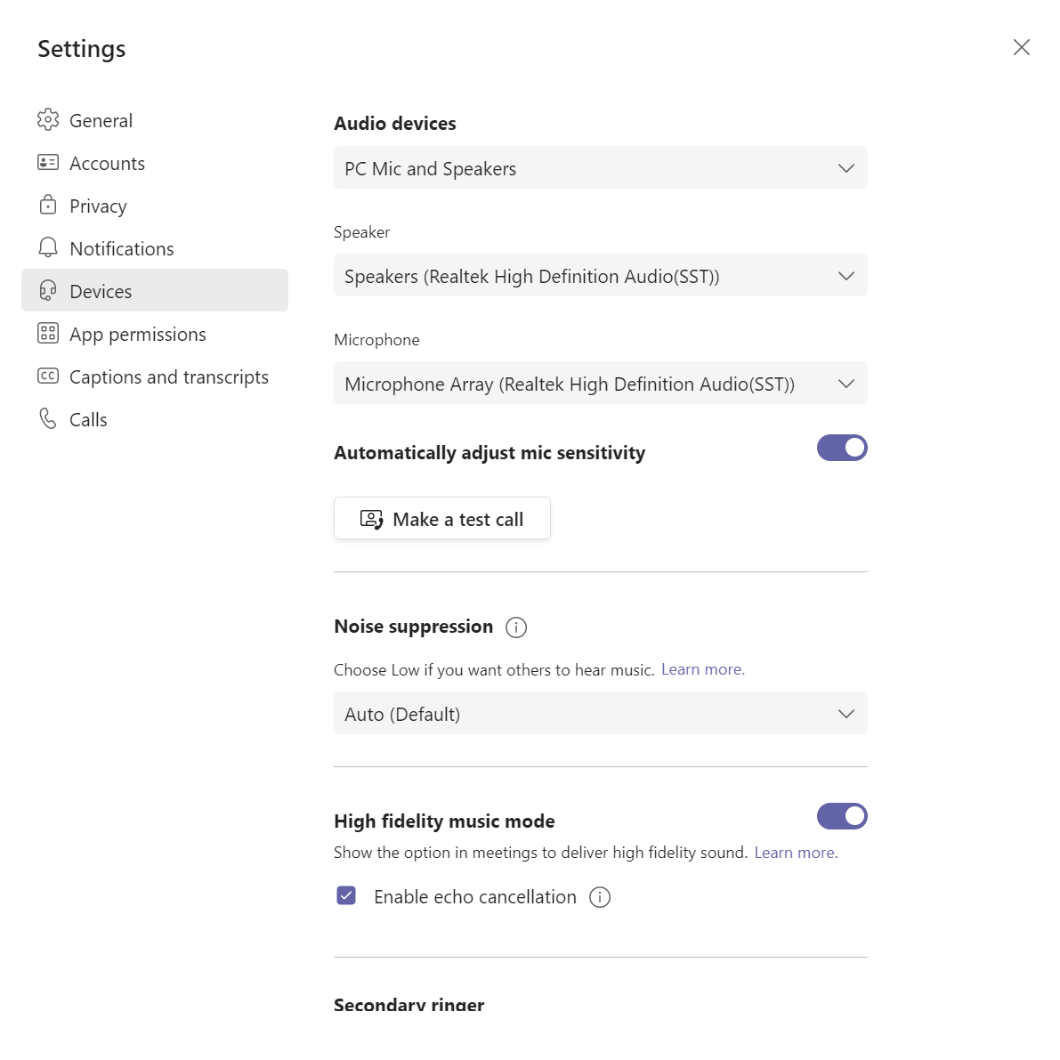
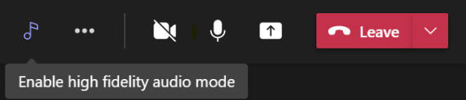
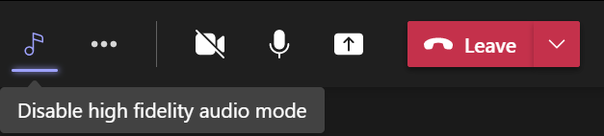
Music Mode for Teams

Slide 11
Neuigkeiten in Microsoft Teams
View Switcher - a new dedicated menu of view options in Teams Meetings
Music Mode for Teams (→ November)
Paging in Large Gallery – Video Gallery 3x3 (→ November)
Lists in Microsoft Teams: Comment and @mention people on list items in Teams Weitere Informationen
Microsoft Viva: Praise History in Microsoft Viva Insights (→ November) Weitere Informationen
Teams Meeting Recordings Auto-Expiration in OneDrive and SharePoint (→ November) Weitere Informationen

Slide 12
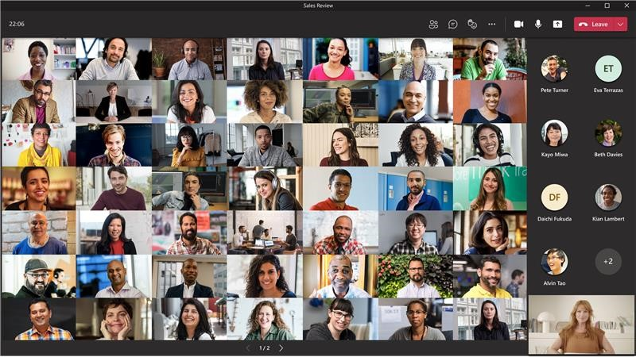
Paging in Large Gallery

Slide 13
Neuigkeiten in Microsoft Teams
View Switcher - a new dedicated menu of view options in Teams Meetings
Music Mode for Teams (→ November)
Paging in Large Gallery – Video Gallery 3x3 (→ November)
Lists in Microsoft Teams: Comment and @mention people on list items in Teams Weitere Informationen
Microsoft Viva: Praise History in Microsoft Viva Insights (→ November) Weitere Informationen
Teams Meeting Recordings Auto-Expiration in OneDrive and SharePoint (→ November) Weitere Informationen

Slide 14
Neuigkeiten in Microsoft Teams
View Switcher - a new dedicated menu of view options in Teams Meetings
Music Mode for Teams (→ November)
Paging in Large Gallery – Video Gallery 3x3 (→ November)
Lists in Microsoft Teams: Comment and @mention people on list items in Teams Weitere Informationen
Microsoft Viva: Praise History in Microsoft Viva Insights (→ November) Weitere Informationen
Teams Meeting Recordings Auto-Expiration in OneDrive and SharePoint (→ November) Weitere Informationen

Slide 15
Neuigkeiten in Microsoft Teams
View Switcher - a new dedicated menu of view options in Teams Meetings
Music Mode for Teams (→ November)
Paging in Large Gallery – Video Gallery 3x3 (→ November)
Lists in Microsoft Teams: Comment and @mention people on list items in Teams Weitere Informationen
Microsoft Viva: Praise History in Microsoft Viva Insights (→ November) Weitere Informationen
Teams Meeting Recordings Auto-Expiration in OneDrive and SharePoint (→ November) Weitere Informationen

Slide 16
Neuigkeiten in Microsoft Teams
A new search results page is coming (→ November)
Content from camera now launched in Teams
Hardware Support for AJA and Blackmagic Devices Weitere Informationen
Introducing background effects on web
Microsoft Teams Room on Windows - In meeting experience update
End-to-end encryption for Teams calling (→ November)
Restarting a Teams Live Event

Slide 17
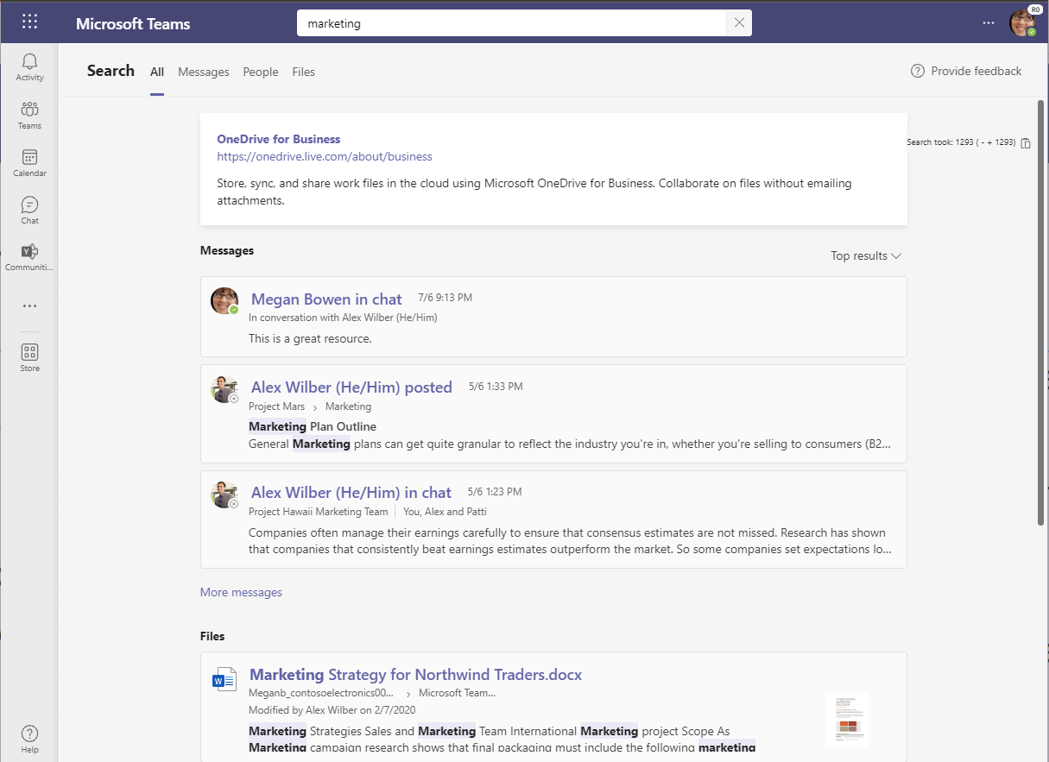
A new search results page is coming

Slide 18
Neuigkeiten in Microsoft Teams
A new search results page is coming (→ November)
Content from camera now launched in Teams
Hardware Support for AJA and Blackmagic Devices Weitere Informationen
Introducing background effects on web
Microsoft Teams Room on Windows - In meeting experience update
End-to-end encryption for Teams calling (→ November)
Restarting a Teams Live Event

Slide 19
Content from camera now launched in Teams
Zwei Projektionsmodi
Whiteboard
Dokument
Bei aktivierter „Allow IP Video“-Richtlinie ist das Feature automatisch eingeschaltet
Besprechungsrichtlinien – Audio & Video

Slide 20
Neuigkeiten in Microsoft Teams
A new search results page is coming (→ November)
Content from camera now launched in Teams
Hardware Support for AJA and Blackmagic Devices Weitere Informationen
Introducing background effects on web
Microsoft Teams Room on Windows - In meeting experience update
End-to-end encryption for Teams calling (→ November)
Restarting a Teams Live Event

Slide 21
Neuigkeiten in Microsoft Teams
A new search results page is coming (→ November)
Content from camera now launched in Teams
Hardware Support for AJA and Blackmagic Devices Weitere Informationen
Introducing background effects on web
Microsoft Teams Room on Windows - In meeting experience update
End-to-end encryption for Teams calling (→ November)
Restarting a Teams Live Event

Slide 22
Neuigkeiten in Microsoft Teams
A new search results page is coming (→ November)
Content from camera now launched in Teams
Hardware Support for AJA and Blackmagic Devices Weitere Informationen
Introducing background effects on web
Microsoft Teams Room on Windows - In meeting experience update
End-to-end encryption for Teams calling (→ November)
Restarting a Teams Live Event

Slide 23
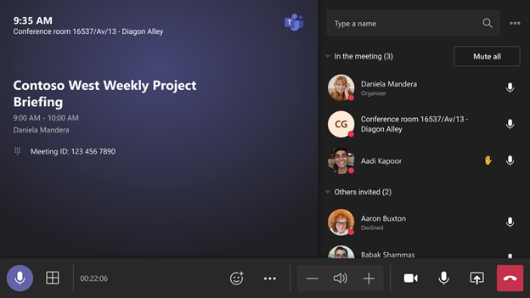
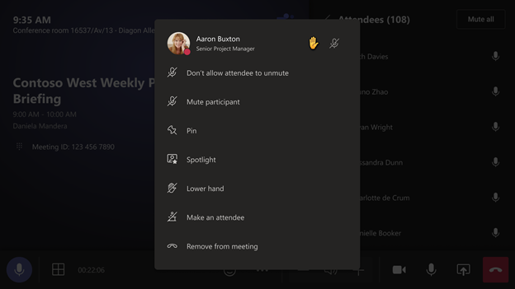
Microsoft Teams Room on Windows - In meeting experience update – 1

Slide 24

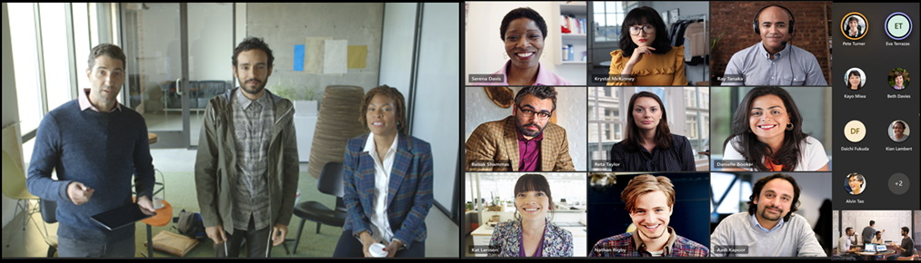
Microsoft Teams Room on Windows - In meeting experience update – 2

Slide 25
Neuigkeiten in Microsoft Teams
A new search results page is coming (→ November)
Content from camera now launched in Teams
Hardware Support for AJA and Blackmagic Devices Weitere Informationen
Introducing background effects on web
Microsoft Teams Room on Windows - In meeting experience update
End-to-end encryption for Teams calling (→ November)
Restarting a Teams Live Event

Slide 26
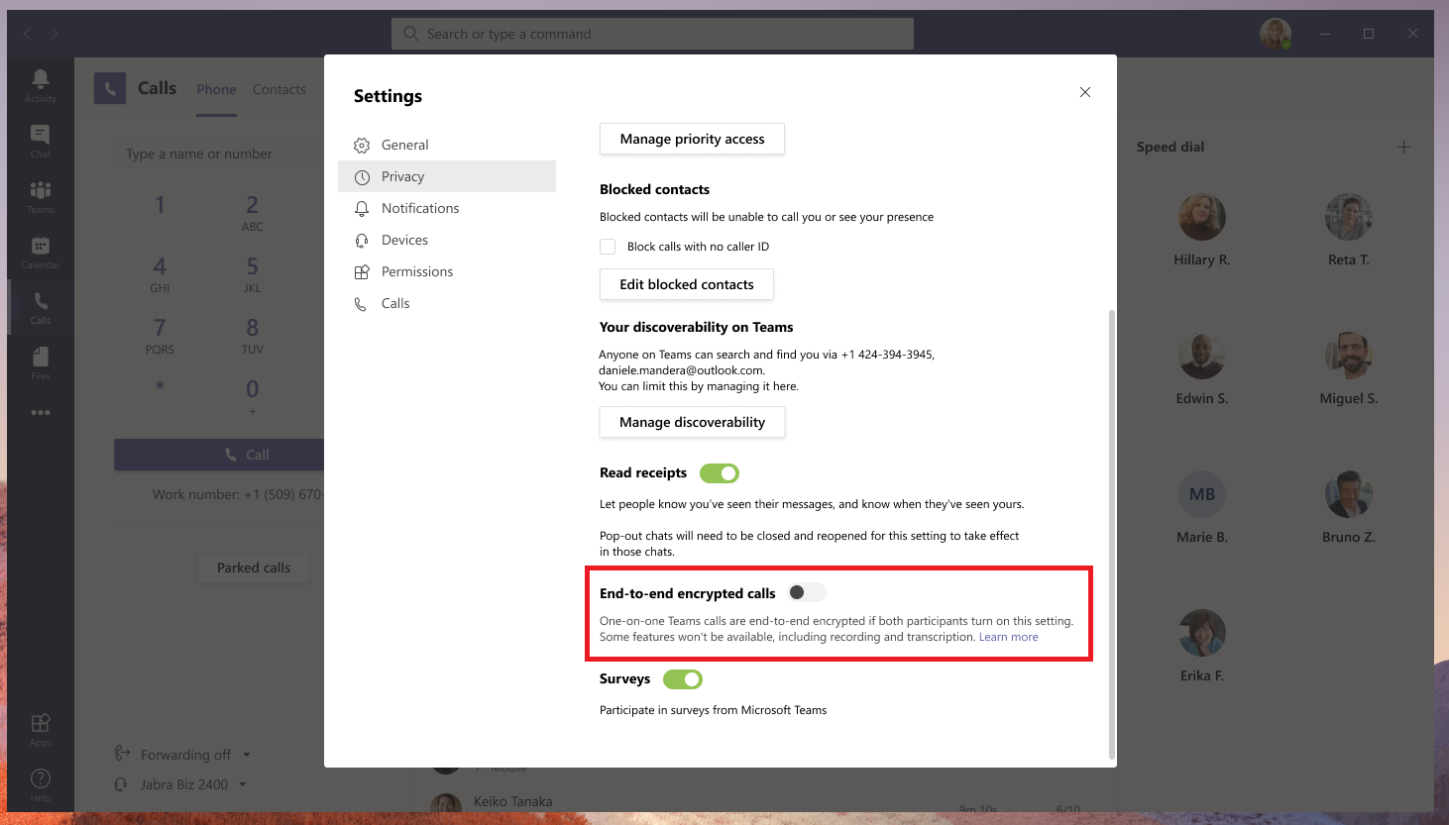
End-to-end encryption for Teams calling

Slide 27
Neuigkeiten in Microsoft Teams
A new search results page is coming (→ November)
Content from camera now launched in Teams
Hardware Support for AJA and Blackmagic Devices Weitere Informationen
Introducing background effects on web
Microsoft Teams Room on Windows - In meeting experience update
End-to-end encryption for Teams calling (→ November)
Restarting a Teams Live Event

Slide 28
Neuigkeiten in Microsoft Teams
1:1 Calling in Safari
Join meetings anonymously from your Teams desktop app Weitere Informationen
Reply to specific chat message in Teams Desktop
Breakout rooms: Pre-meeting room creation and participant assignment
Breakout Rooms Presenter support

Slide 29
Neuigkeiten in Microsoft Teams
1:1 Calling in Safari
Join meetings anonymously from your Teams desktop app Weitere Informationen
Reply to specific chat message in Teams Desktop
Breakout rooms: Pre-meeting room creation and participant assignment
Breakout Rooms Presenter support

Slide 30
Neuigkeiten in Microsoft Teams
1:1 Calling in Safari
Join meetings anonymously from your Teams desktop app Weitere Informationen
Reply to specific chat message in Teams Desktop
Breakout rooms: Pre-meeting room creation and participant assignment
Breakout Rooms Presenter support

Slide 31
Reply to specific chat message in Teams Desktop

Slide 32
Neuigkeiten in Microsoft Teams
1:1 Calling in Safari
Join meetings anonymously from your Teams desktop app Weitere Informationen
Reply to specific chat message in Teams Desktop
Breakout rooms: Pre-meeting room creation and participant assignment
Breakout Rooms Presenter support

Slide 33
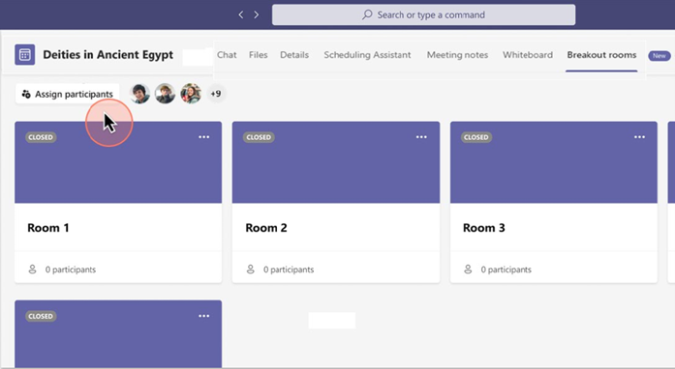
Breakout rooms: Pre-meeting room creation and participant assignment
Vor einem Meeting
Bulk-Erstellung, -Löschung
Einzelerstellung, -löschung
Umbennen
Anpassung der Einstellungen
Zuweisung von Teilnehmern
Während eines Meetings
Verwaltung über BR-Panel im Meeting
Nur eingeladene Teilnehmer können zugewiesen werden
Weitere Informationen

Slide 34
Neuigkeiten in Microsoft Teams
1:1 Calling in Safari
Join meetings anonymously from your Teams desktop app Weitere Informationen
Reply to specific chat message in Teams Desktop
Breakout rooms: Pre-meeting room creation and participant assignment
Breakout Rooms Presenter support

Slide 35
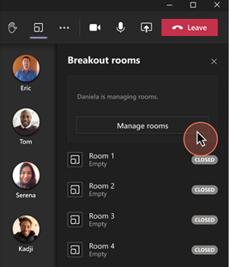
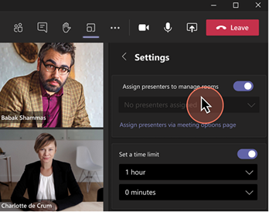
Breakout Rooms Presenter support
Notes:
Desktop only

Slide 36
Neuigkeiten in Microsoft Teams für Admins
Records Management - Announcing public preview of adaptive policy scopes for retention and label policies Weitere Information
Meeting Join Custom Branding (→ November)
Teams Support of Internal Guest User
Azure Cloud shell in Teams Admin Center Weitere Informationen
Peer5 now available for Teams Live Events Weitere Informationen
End-to-end encryption for Teams calling (→ November) Weitere Informationen
Operator Connect for Microsoft Teams moving to general availability

Slide 37
Neuigkeiten in Microsoft Teams für Admins
Records Management - Announcing public preview of adaptive policy scopes for retention and label policies Weitere Information
Meeting Join Custom Branding (→ November)
Teams Support of Internal Guest User
Azure Cloud shell in Teams Admin Center Weitere Informationen
Peer5 now available for Teams Live Events Weitere Informationen
End-to-end encryption for Teams calling (→ November) Weitere Informationen
Operator Connect for Microsoft Teams moving to general availability

Slide 38
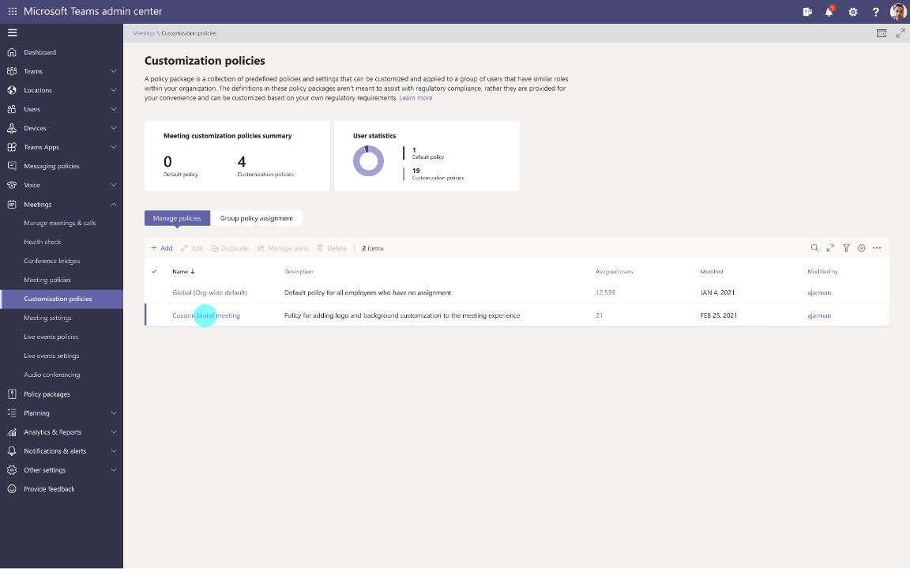
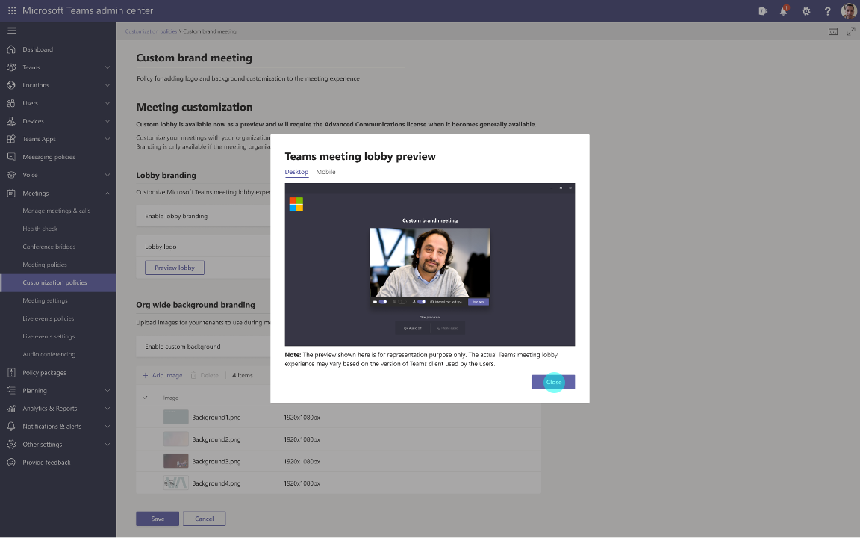
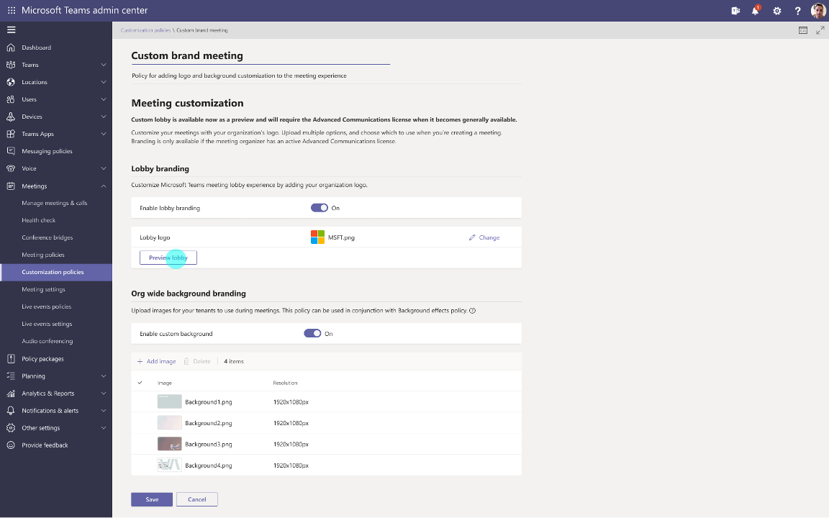
Meeting Join Custom Branding
Organisator benötigt eine Advanced Communications License (Link)

Slide 39
Neuigkeiten in Microsoft Teams für Admins
Records Management - Announcing public preview of adaptive policy scopes for retention and label policies Weitere Information
Meeting Join Custom Branding (→ November)
Teams Support of Internal Guest User
Azure Cloud shell in Teams Admin Center Weitere Informationen
Peer5 now available for Teams Live Events Weitere Informationen
End-to-end encryption for Teams calling (→ November) Weitere Informationen
Operator Connect for Microsoft Teams moving to general availability

Slide 40
Teams Support of Internal Guest User
Betrifft State 3 und State 4 Kontentypen
Properties of an Azure Active Directory B2B collaboration user
Comparison of team member and guest capabilities
Guest access in Microsoft Teams

Slide 41
Azure AD Kontentypen
User
Member User Emplyee, Vendor, etc. on org payroll UserType = Member
Homed in Org directory
traditional B2E scenario
Cloud-only accounts
Syncronized on-premises accounts
Homed in external directory
External Azure AD (AAD B2B – invite as member)
Microsoft Account
Guest B2B User not on org payroll UserType = Guest
Homed in Org directory Additonal accounts for partners
Cloud-Only accounts
Syncronized on-premises accounts
Homed in external directory Default B2B model
External Azure AD
Microsoft Account
State 4
State 3
State 1
State 2

Slide 42
Neuigkeiten in Microsoft Teams für Admins
Records Management - Announcing public preview of adaptive policy scopes for retention and label policies Weitere Information
Meeting Join Custom Branding (→ November)
Teams Support of Internal Guest User
Azure Cloud shell in Teams Admin Center Weitere Informationen
Peer5 now available for Teams Live Events Weitere Informationen
End-to-end encryption for Teams calling (→ November) Weitere Informationen
Operator Connect for Microsoft Teams moving to general availability

Slide 43
Neuigkeiten in Microsoft Teams für Admins
Records Management - Announcing public preview of adaptive policy scopes for retention and label policies Weitere Information
Meeting Join Custom Branding (→ November)
Teams Support of Internal Guest User
Azure Cloud shell in Teams Admin Center Weitere Informationen
Peer5 now available for Teams Live Events Weitere Informationen
End-to-end encryption for Teams calling (→ November) Weitere Informationen
Operator Connect for Microsoft Teams moving to general availability

Slide 44
Neuigkeiten in Microsoft Teams für Admins
Records Management - Announcing public preview of adaptive policy scopes for retention and label policies Weitere Information
Meeting Join Custom Branding (→ November)
Teams Support of Internal Guest User
Azure Cloud shell in Teams Admin Center Weitere Informationen
Peer5 now available for Teams Live Events Weitere Informationen
End-to-end encryption for Teams calling (→ November) Weitere Informationen
Operator Connect for Microsoft Teams moving to general availability

Slide 45
Neuigkeiten in Microsoft Teams für Admins
Records Management - Announcing public preview of adaptive policy scopes for retention and label policies Weitere Information
Meeting Join Custom Branding (→ November)
Teams Support of Internal Guest User
Azure Cloud shell in Teams Admin Center Weitere Informationen
Peer5 now available for Teams Live Events Weitere Informationen
End-to-end encryption for Teams calling (→ November) Weitere Informationen
Operator Connect for Microsoft Teams moving to general availability

Slide 46
End-to-end encryption for Teams calling
E2E wird zuerst nur einfache Anruffunktionen unterstützen Zunächst nicht unterstützte Funktionen
Eskalation, Anruf-Weitergabe, Aufnahme, Untertitel
E2E muss für beide Teilnehmer aktiviert sein
Nur für Teams Desktop und Teams Mobile

Slide 47
Neuigkeiten in Microsoft Teams für Admins
Records Management - Announcing public preview of adaptive policy scopes for retention and label policies Weitere Information
Meeting Join Custom Branding (→ November)
Teams Support of Internal Guest User
Azure Cloud shell in Teams Admin Center Weitere Informationen
Peer5 now available for Teams Live Events Weitere Informationen
End-to-end encryption for Teams calling (→ November) Weitere Informationen
Operator Connect for Microsoft Teams moving to general availability

Slide 48
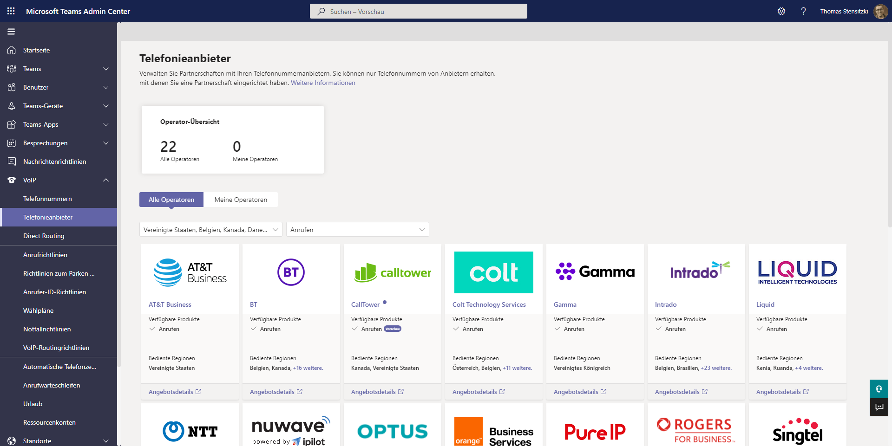
Operator Connect for Microsoft Teams moving to general availability
Dritte Option zur PSTN-Anbindung
Bisher: MS Cloud-PBX mit Anrufplänen oder DirectRouting
Blog-Artikel

Slide 49
Neuigkeiten in Microsoft Teams für Admins
1:1 VOIP and PSTN call recording and transcription in Calls App V2

Slide 50
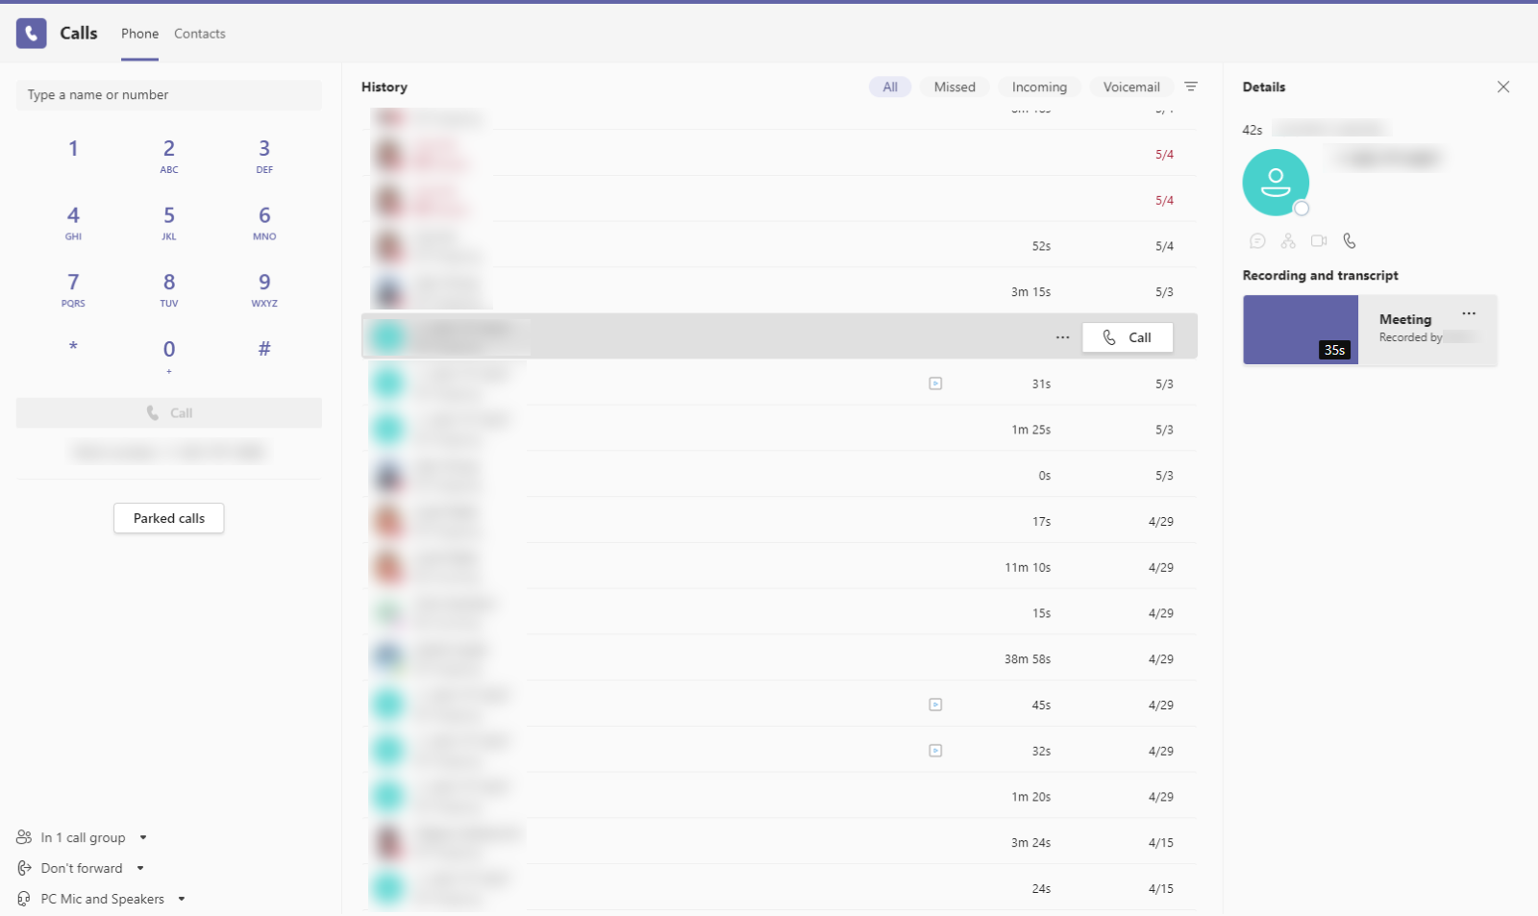
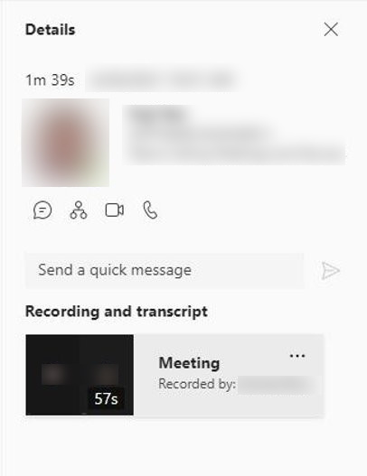
1:1 VOIP and PSTN call recording and transcription in Calls App V2 – 1
Notes:
Teams admins will need to make sure that AllowCloudRecordingForCalls and AllowTranscriptionForCalling is turned on to enable recording and transcription of 1:1 VOIP and PSTN calls.

Slide 51
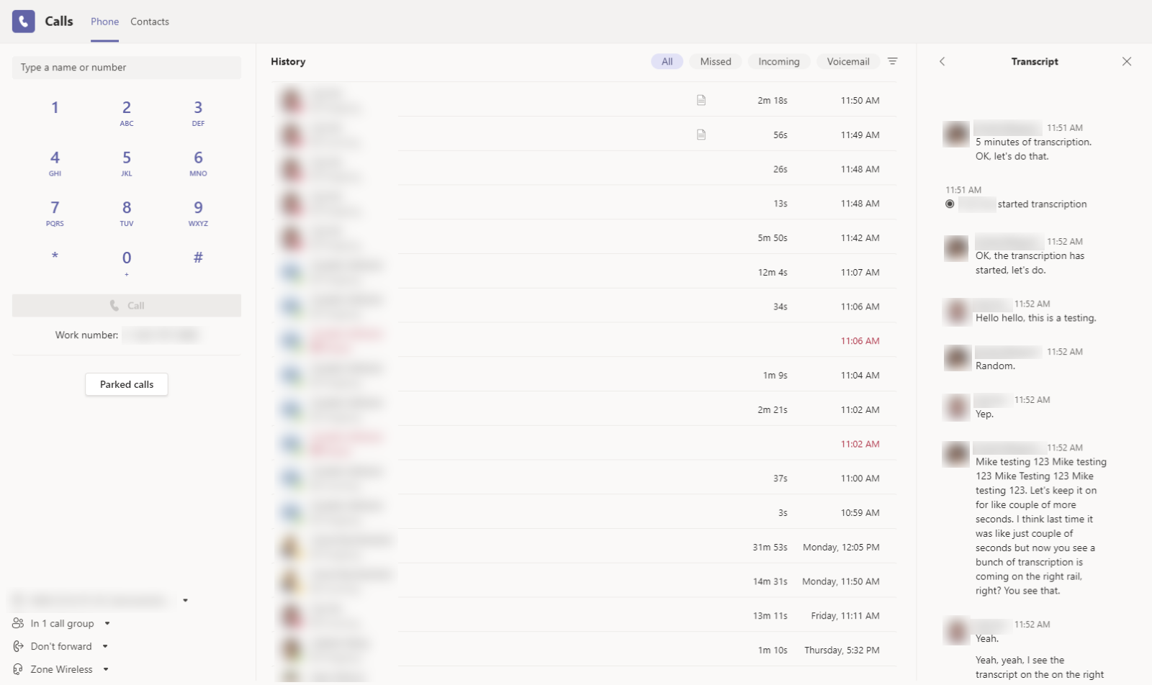
1:1 VOIP and PSTN call recording and transcription in Calls App V2

Slide 52
Was ist neu in Teams – Der Blog
What’s New in Microsoft Teams – August 2021
What‘s New in Microsoft Teams – September 2021
Microsoft Teams Blog

Slide 53
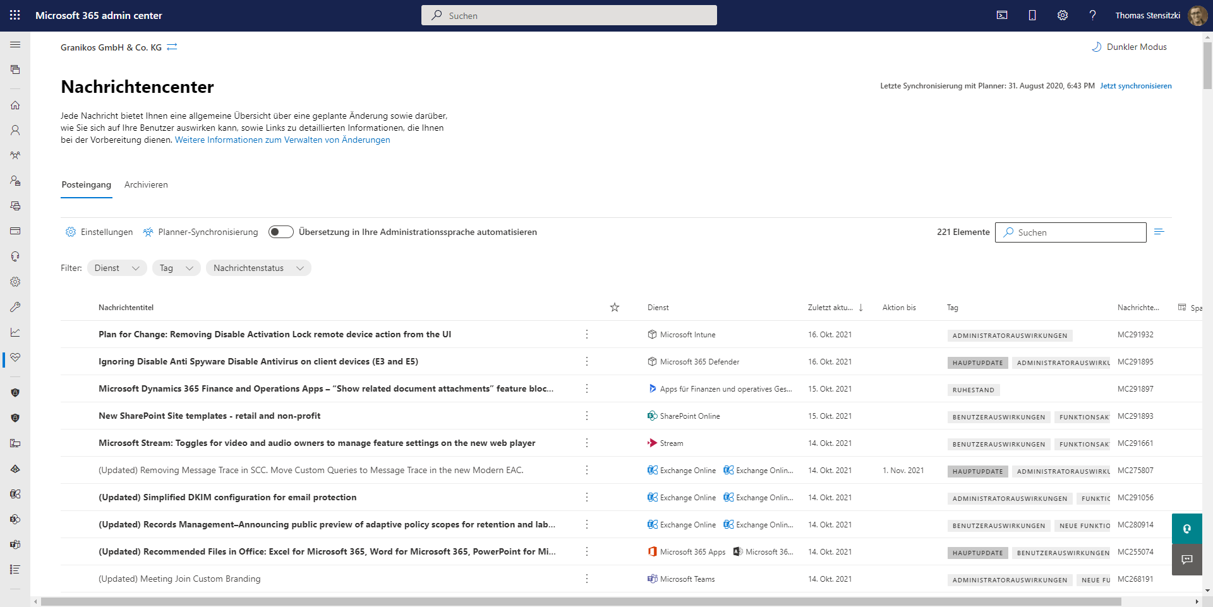
https://admin.microsoft.com/#/MessageCenter

Slide 54
Ultimate guide to Teams meetings
Marcin Siewnicki @MarcinSiewnicki

Slide 55
Organisatorisches

Slide 56
Veranstaltungen
Datum
2. – 4. November | Microsoft Ignite
29. November – 1. Dezember | European Collaboration Summit
28. Januar 2022 | Teams Community Day Hybride Veranstaltung, Treffpunkt in Berlin
6. April 2022 | Teams Nation

Slide 57
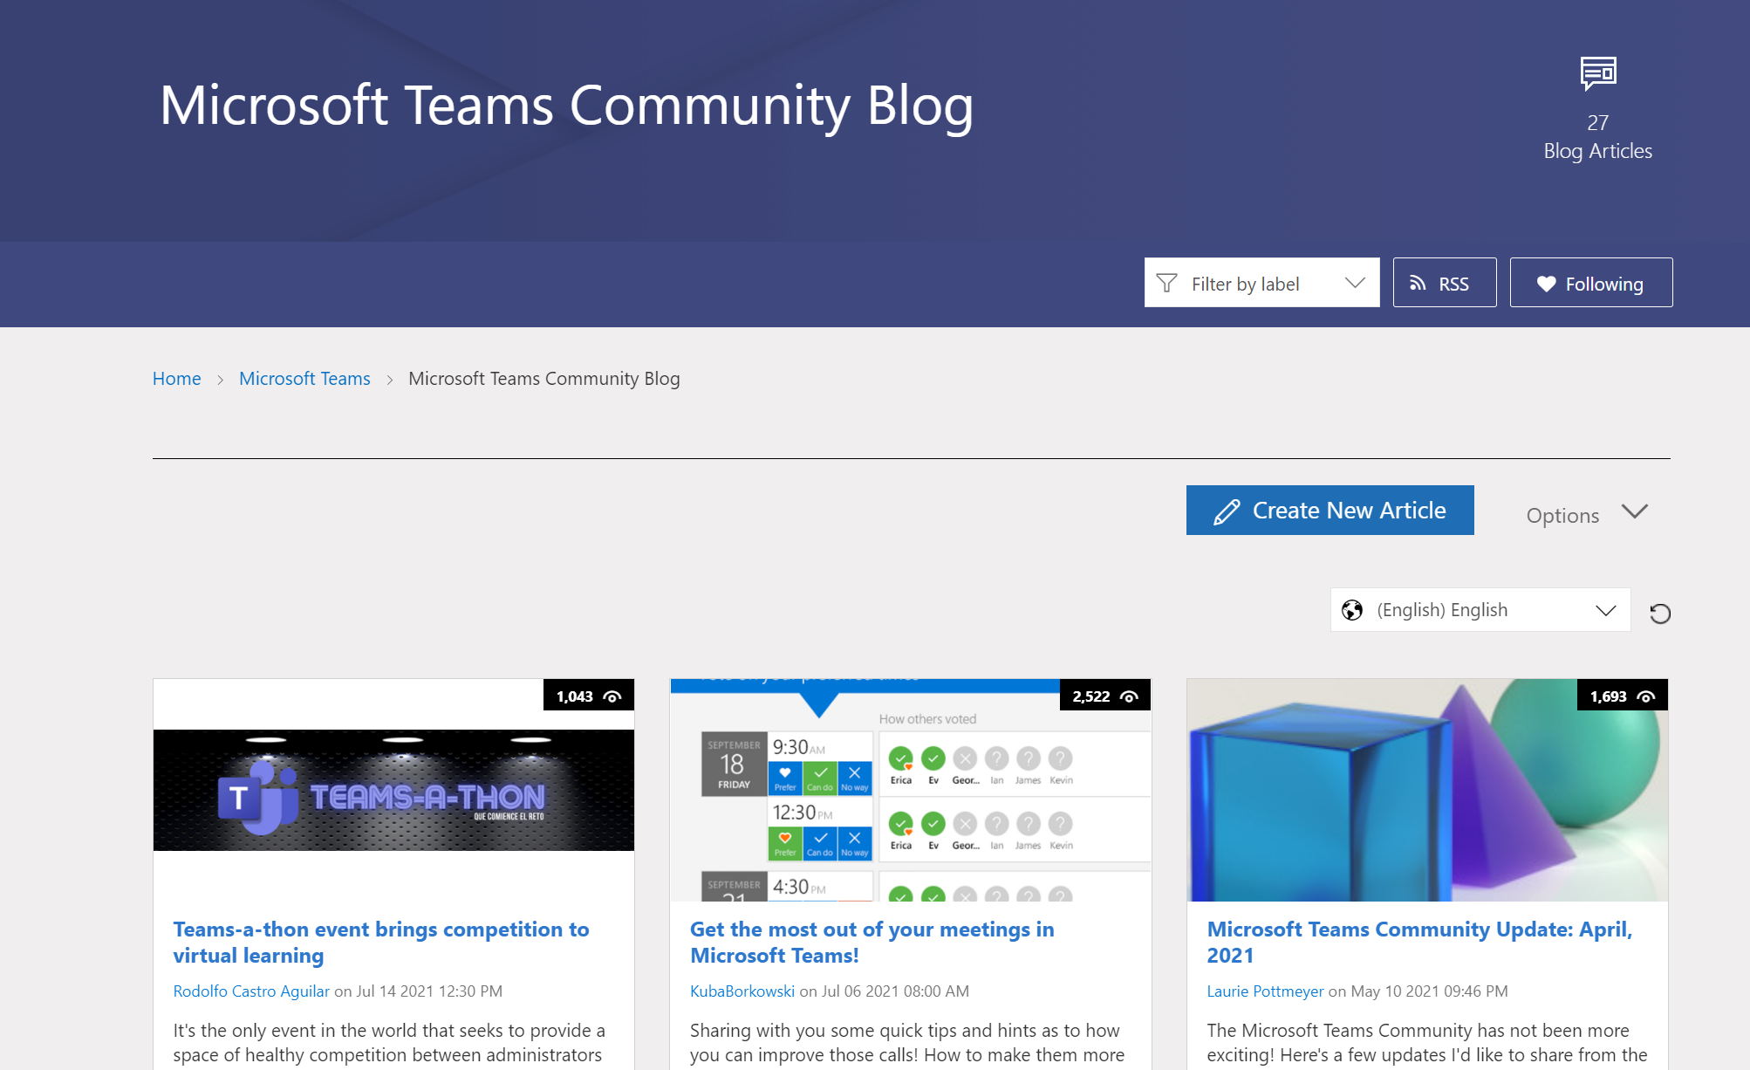
Teams Community Blog
→https://aka.ms/TeamsCommunityBlogger

Slide 58
Organisatorisches
Microsoft Community Tenant für User Groups
Teilnahme als Microsoft 365 Gast
Anmeldung: https://go.granikos.eu/TeamsUGForm
Einheitlicher Teams Meeting Teilnahme-Link
https://teamsusergroup.berlin/meetup

Slide 59
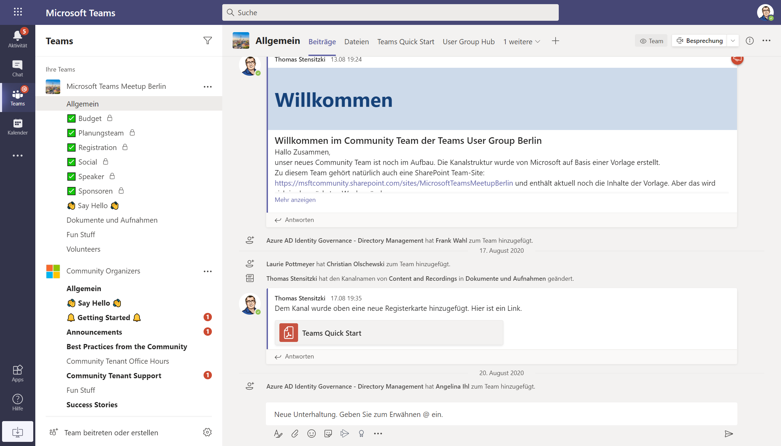

Slide 60
Vielen Dank für eure Teilnahme!
Das nächste Meetup:
→ 2. Dezember 2021
https://TeamsUserGroup.Berlin
Spread the Word!
#TeamsUGBerlin
Aufzeichnungen unserer Meetups sind im Community Team und bei YouTube verfügbar.

Slide 61
Offene Diskussion

